Slide 1
Examples of effective university program pages November 14, 2016

Slide 2
Program homepage
http://www.kcl.ac.uk/study/postgraduate/taught-courses/engineering-with-management-msc.aspx

Slide 3
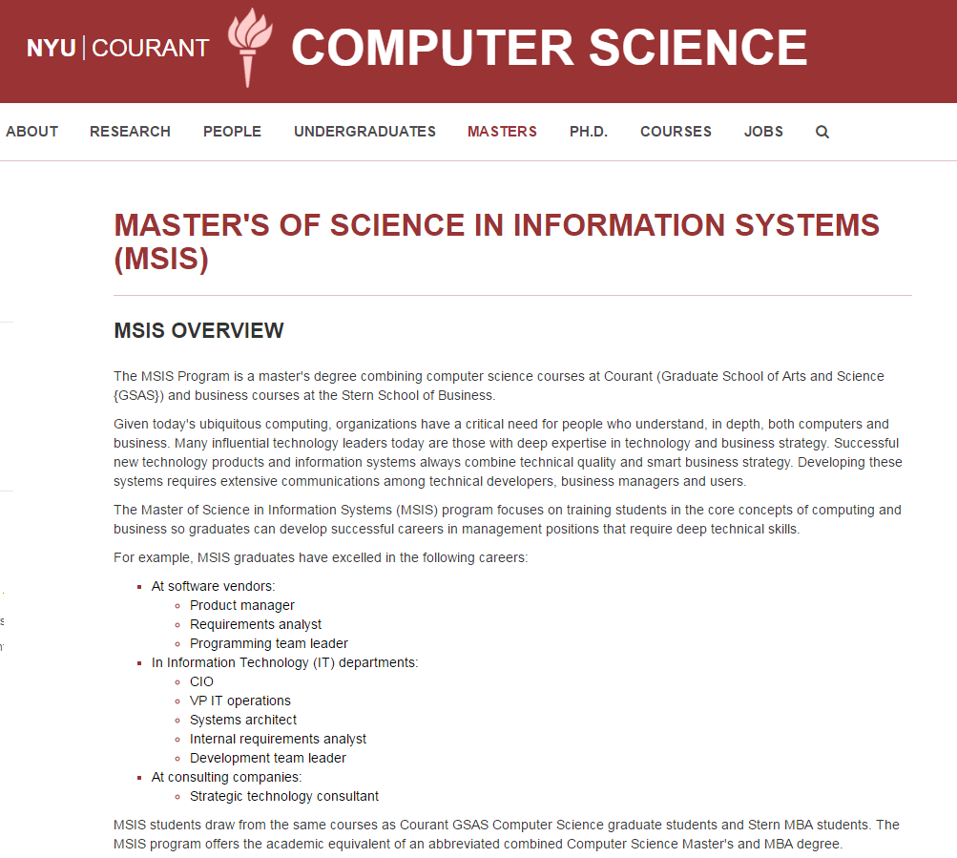
About: Overview
http://cs.nyu.edu/home/master/prospective_msis.html

Slide 4
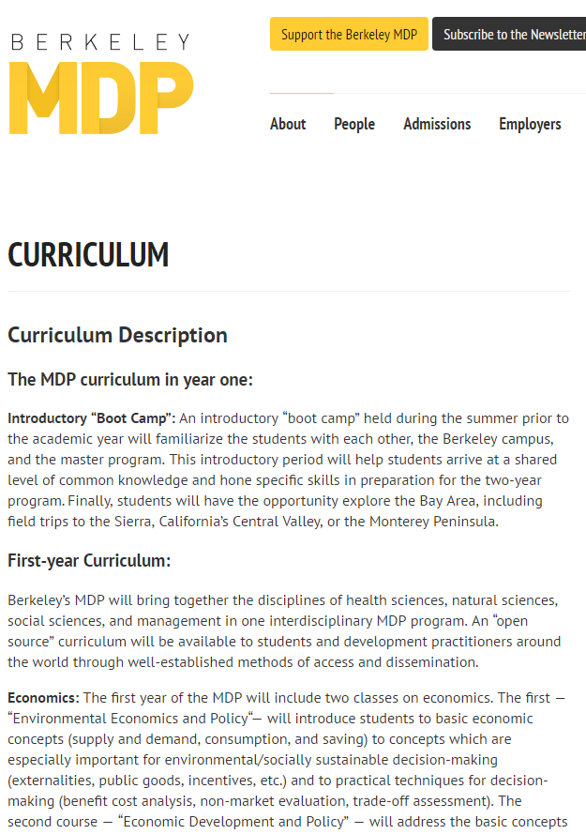
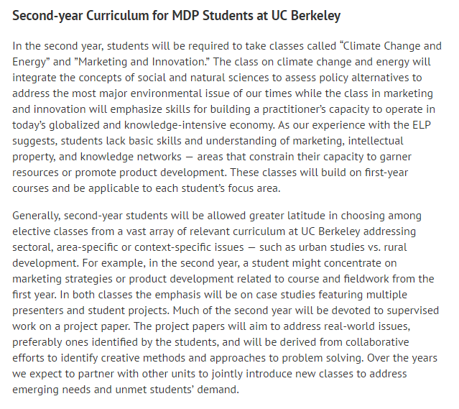
About: Curriculum
https://mdp.berkeley.edu/curriculum/

Slide 5
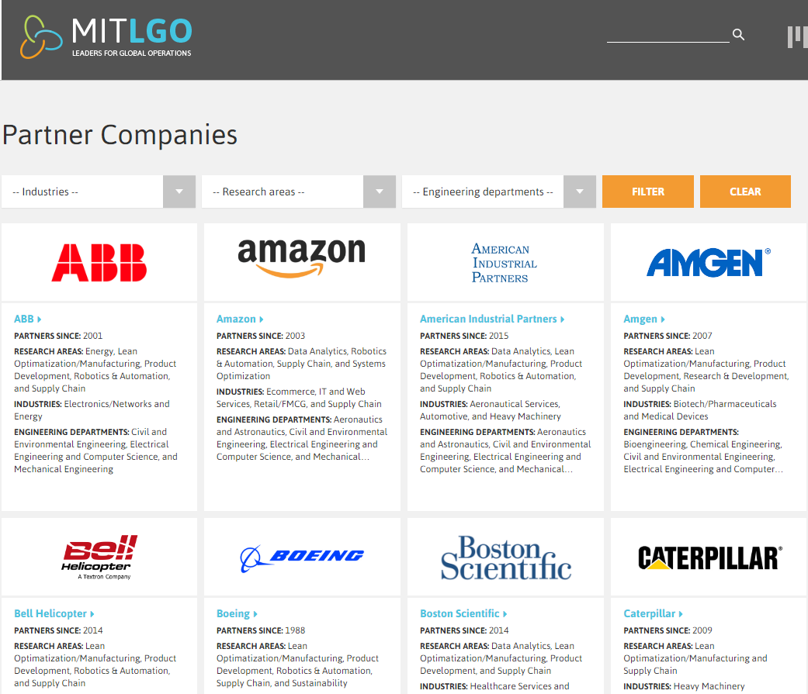
About: Partners
https://lgo.mit.edu/partner-companies/

Slide 6
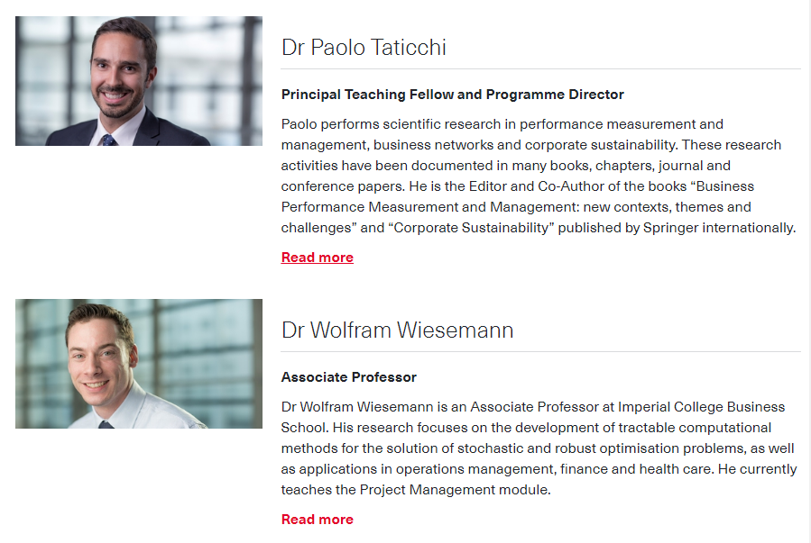
About: Faculty members
https://wwwf.imperial.ac.uk/business-school/programmes/msc-management/our-community/faculty-profiles/

Slide 7
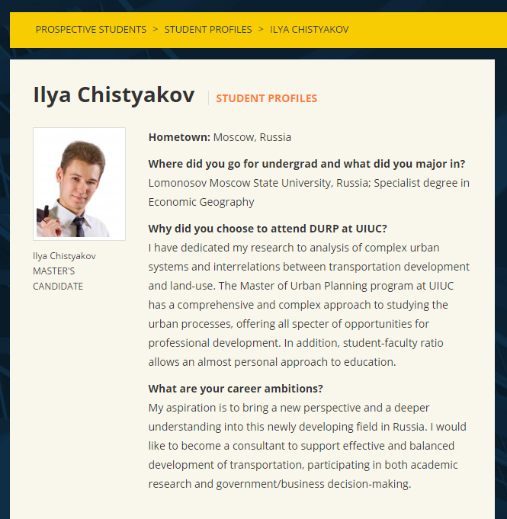
About: Student profiles
http://www.urban.illinois.edu/prospective-students/student-profiles

Slide 8
About: Alumni
http://earthsciences.dartmouth.edu/people/laura-levy

Slide 9
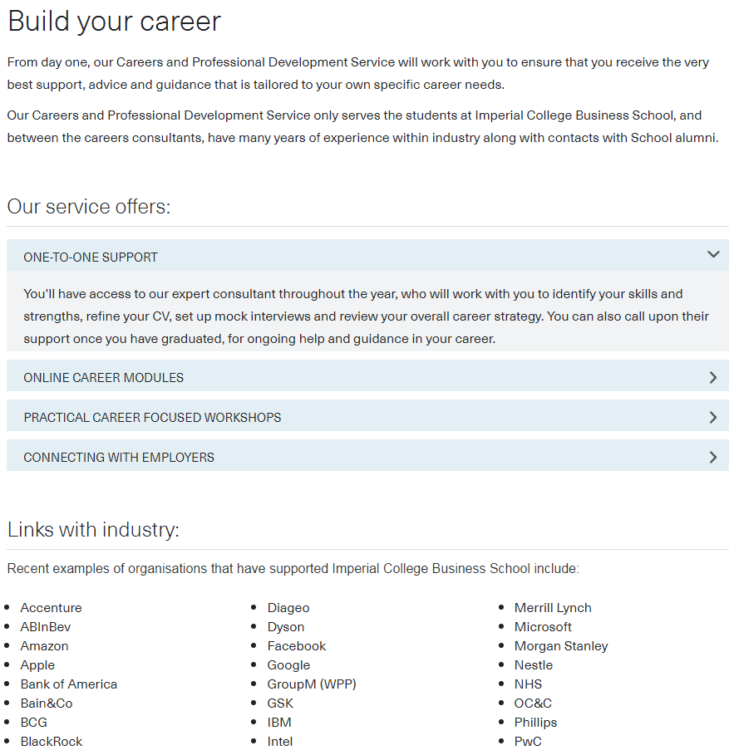
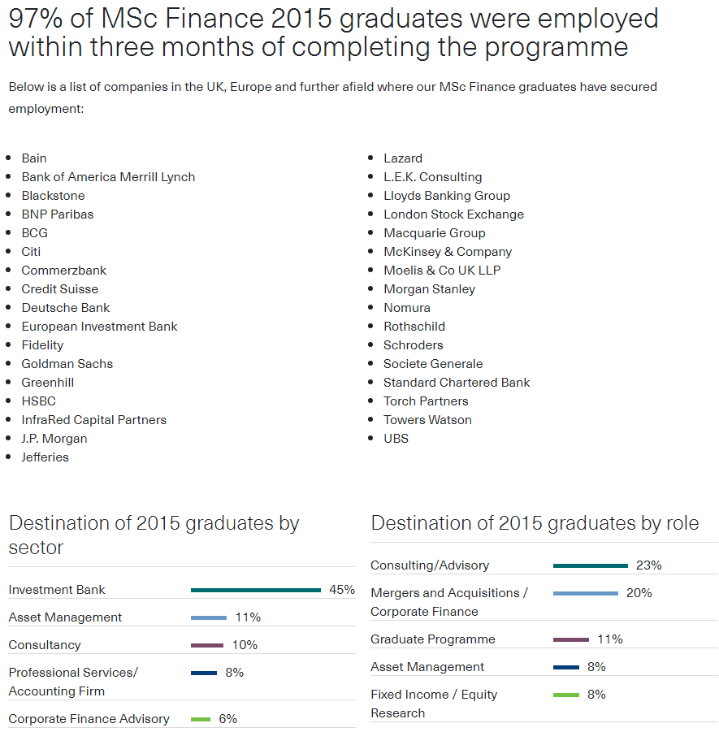
About: Career opportunities
https://wwwf.imperial.ac.uk/business-school/programmes/msc-finance/build-your-career/
https://wwwf.imperial.ac.uk/business-school/programmes/msc-finance/programme-outcomes/

Slide 10
For Applicants: Requirements
https://msc.northwestern.edu/application/

Slide 11
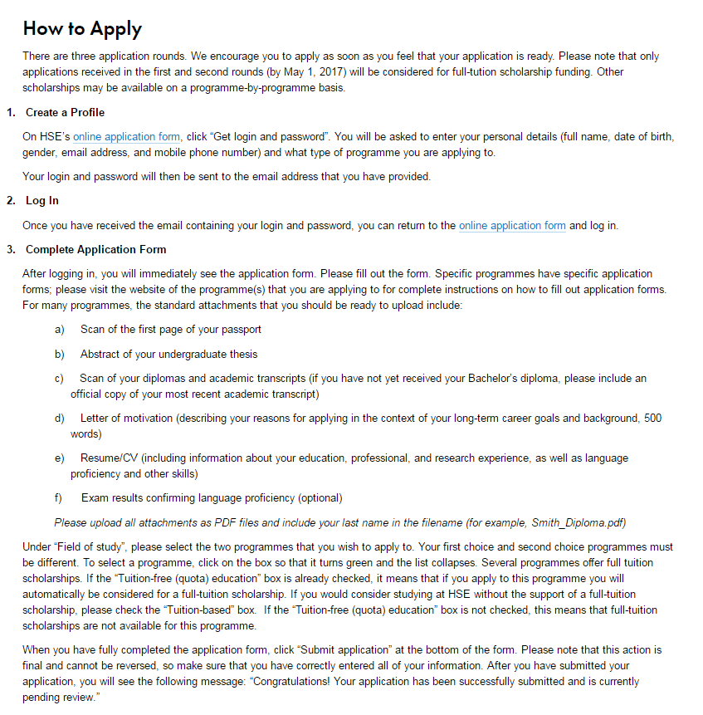
For Applicants: How to apply

Slide 12
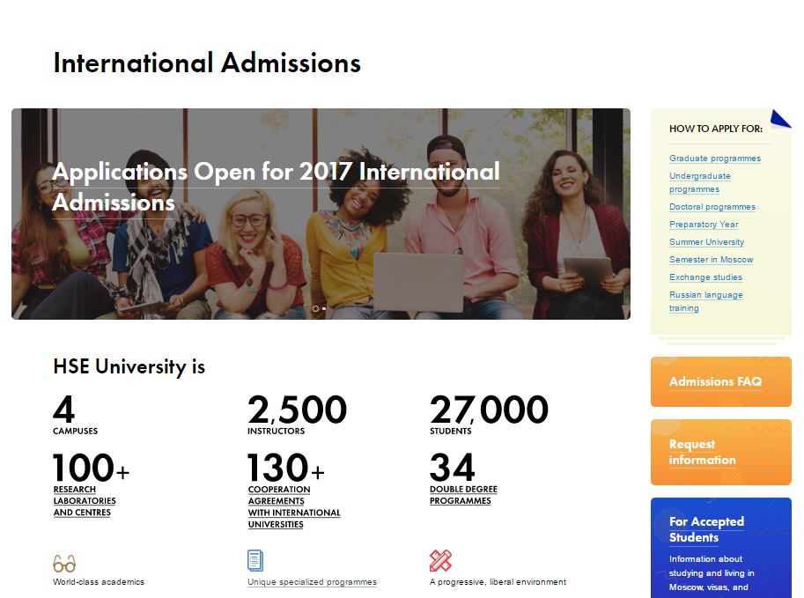
For Applicants: General information
Link to hse.ru/admissions

Slide 13
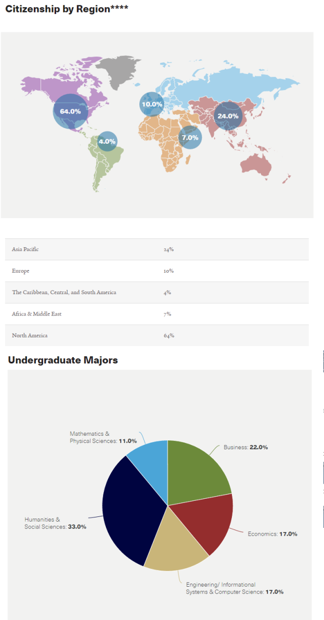
For Applicants: Class profile
https://www.hse.ru/en/ma/sti/statistics
http://som.yale.edu/programs/mba/admissions/class-profile

Slide 14
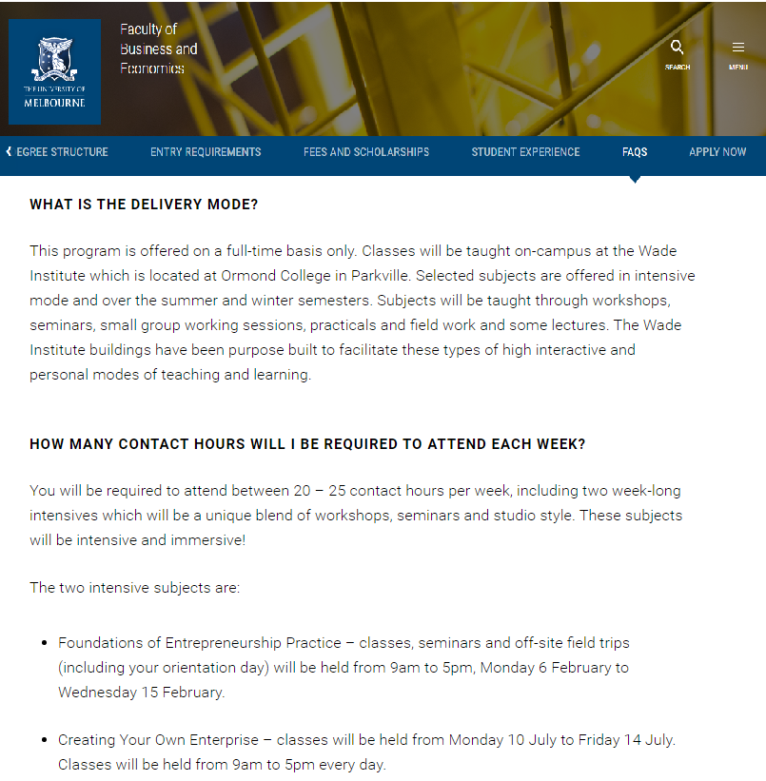
For Applicants: FAQ
http://fbe.unimelb.edu.au/entrepreneurship#faqs

Slide 15
Questions?
Nick Marmet
nmarmet@hse.ru

